Slide 1


Chillax.AI
Stop Stressing, Start Understanding
Your offline, AI-powered code companion for untangling legacy systems
Team: "Pro"crastinators
ET Gen AI Hackathon — Open Novel Innovation Category | Built for Hackathons 🚀

Slide 2
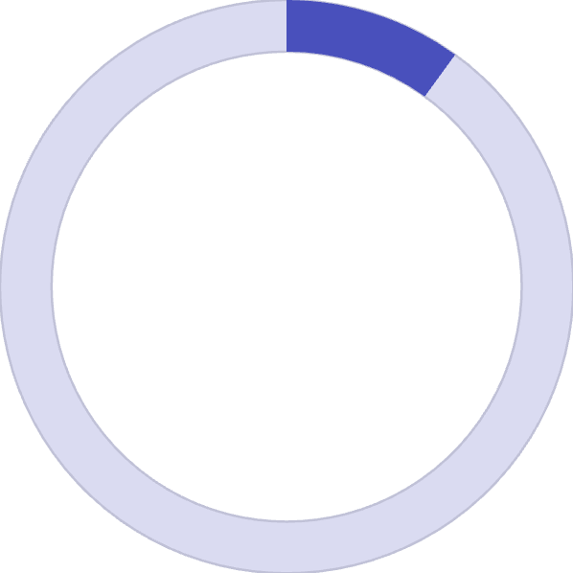

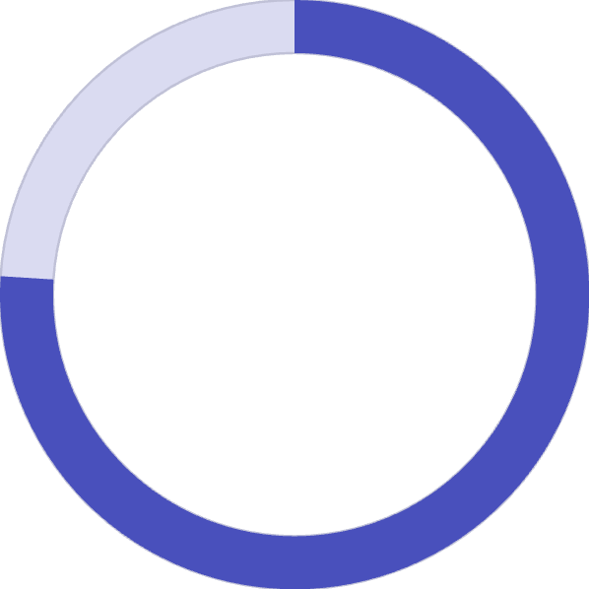

The Problem
Developers are drowning in code they didn't write.
10:1
1–3 Months
76%
Reading vs Writing Code Ratio
Time for First 3 Meaningful PRs
Developers Using Cloud AI Tools
Source: Robert C. Martin, Clean Code
54% of engineering leaders confirm this (Source: Cortex.io, 2024)
That send proprietary code to external servers (Source: Sourcegraph, 2024)
The Gap
Existing AI tools like GitHub Copilot and ChatGPT require sending proprietary code to external servers —
unacceptable for enterprises in finance, healthcare, and defense.
44% of organizations experienced a cloud data breach in 2024, costing an average of $4.88M per breach —
Source: IBM/Forbes, 2024
Tools exist to help developers write faster, but nothing helps them understand existing code at a system level.

Slide 3
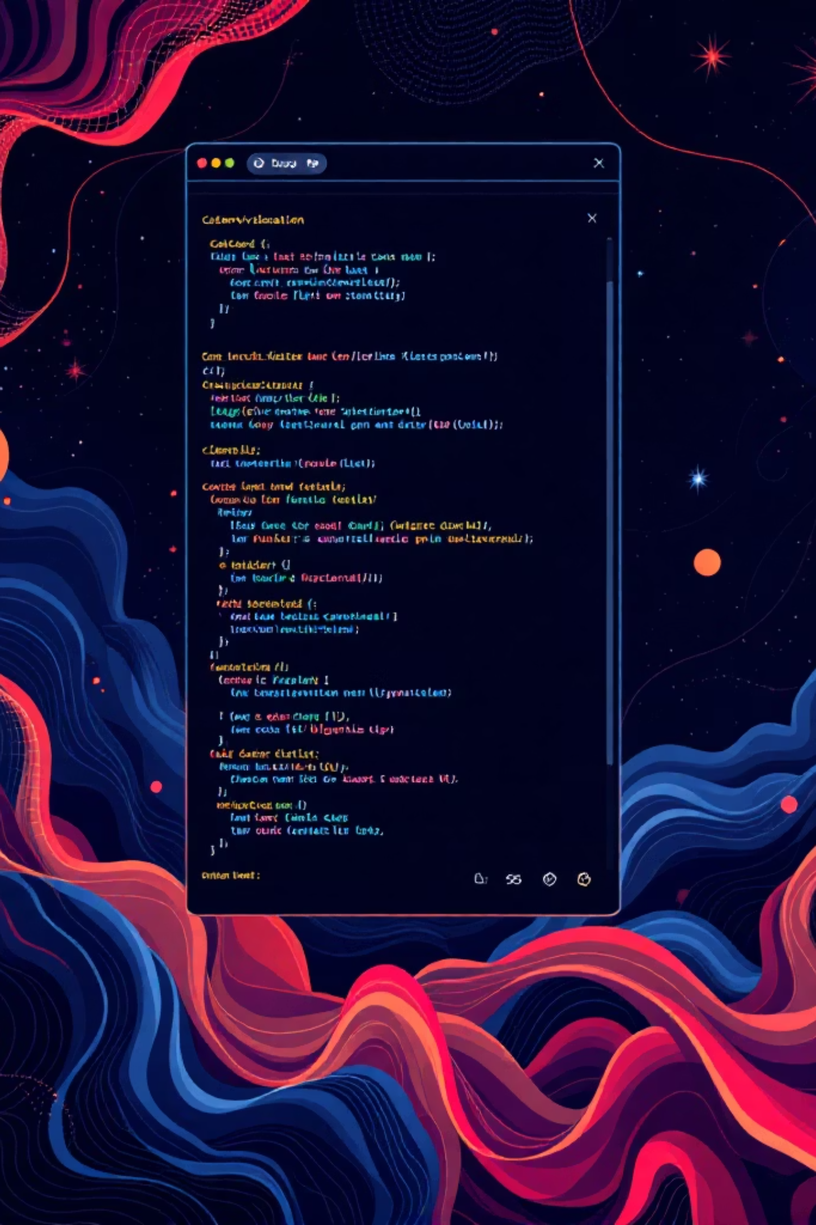



Our Solution
A standalone desktop IDE combining visual mapping, offline AI, and execution visualization.
Interactive Code Map
Offline AI Assistant
Visual graph showing all modules, functions, classes, and their relationships
LLaMA 3 running locally explains code in plain English with full context
Execution Visualizer
Animated walkthrough showing code flow with playback controls

Slide 4





How It Works
Visual Graph Theory + GenAI
Unlike chatbots that just output text, Chillax.AI combines visual mapping with AI comprehension — we show code execution visually.
Privacy-First Architecture
All code analysis and AI processing happens 100% offline on the developer's local machine.
Load Codebase
Zero data leaves the machine. No cloud dependencies.
No proprietary code exposed.
Point to any Python project folder
Analyze Structure
AST parser builds a Knowledge Graph of all functions, classes, and call chains in seconds
Ask Questions
Local LLM answers with full architectural context — no internet needed
Understand Visually
Interactive code map + animated execution flow — not just text
AI-using developers reach their 10th PR in 49 days vs 91 days without AI (Source: DX, 2025)

Slide 5
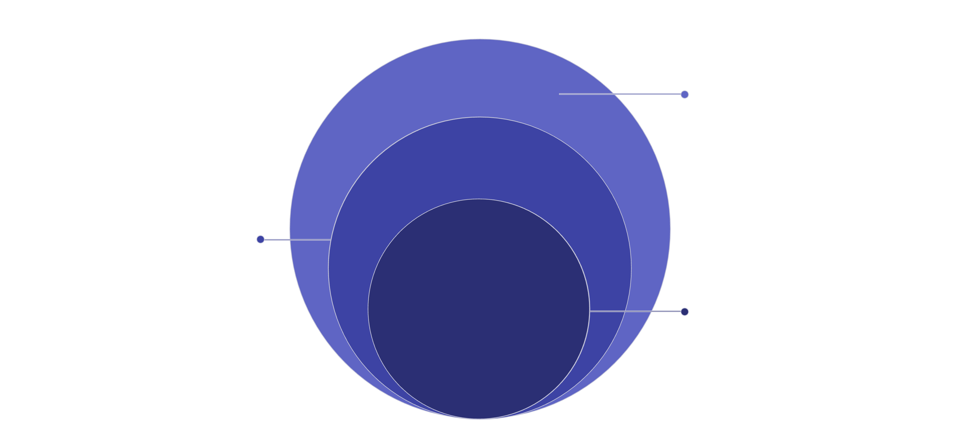

Technical Architecture
Three-Layer Neuro-Symbolic Approach
GenAI + Viz
Generate explanations and interactive visualizations
Knowledge Graph
Represent relations and feed graph to GenAI
Symbolic Analysis
Parse code into AST and extract semantics
Tech Stack: Electron, React 18, Vite, Monaco Editor, FastAPI, Python AST, Ollama, React Flow, Custom dark theme CSS

Slide 6
Validation Strategy
Three complementary approaches to prove effectiveness.
1
Accuracy Testing
2
Performance Benchmarking
3
User Study
Compare AI-generated explanations against ground-truth AST dependency graphs. Target: 90%+ correctness match with AST ground truth
Simulated onboarding tasks measuring time-to-discovery with vs. without Chillax.AI. Target: 50% faster onboarding — aligned with DX 2025 study showing AI devs reach 10th PR in 49 days vs 91 days
Measure inference latency. Target: sub-5-second responses on standard 8GB RAM laptops
Data Sources
Input: User's own local source code (never uploaded anywhere)
AI Models: Open-source LLMs via Ollama (LLaMA 3, CodeLlama, Mistral)
Demo: Bundled sample e-commerce Python project — entirely self-contained, no internet required

Slide 7



Target Users & Use Cases
Privacy-Sensitive Industries
Legacy System Maintainers
Computer Science Educators
Banking, healthcare, and defense teams working with proprietary, classified, or regulated codebases that cannot leave local machines. (44% of orgs had a cloud breach in 2024 — IBM/Forbes)
Engineers supporting decade-old codebases that lack documentation but power critical business operations. (54% of leaders say onboarding takes 1–3 months — Cortex.io, 2024)
Professors and TAs using visualization to teach students how complex systems actually work. (10:1 reading-to-writing ratio makes code comprehension the #1 skill gap)
Use Case Scenario
A developer joins a team with a massive, undocumented 10-year-old Python codebase. They open Chillax.AI, visualize the architecture as an interactive graph, and ask "How does the payment module work?" — all without data leaving their machine.

Slide 8

Why Chillax.AI?
Feature
GitHub Copilot
ChatGPT
Chillax.AI
Works Offline
❌
❌
✅ 100% Local
Code Visualization
❌
❌
✅ Interactive Graph
Execution Animation
❌
❌
✅ Step-by-Step
Data Privacy
❌ Cloud
❌ Cloud
✅ Zero data leaves machine
Neuro-Symbolic AI
❌
❌
✅ AST + LLM Hybrid
Neuro-Symbolic Innovation
Truly Offline by Design
Combine deterministic AST parsing with probabilistic LLMs to reduce hallucinations and increase accuracy.
Privacy and security aren't features — they're fundamental to our architecture.
No cloud dependencies.
Visual Execution Flow
Language-Agnostic Future
Go beyond text explanations with animated code execution visualization showing exactly how systems work.
Python-first, but architecture adapts to JavaScript, Java, C++, Go, and more.
Universal legacy platform.
Novelty: Visual Graph Theory + GenAI
This hybrid approach allows us to show code execution visually within a unified interface where developers simultaneously explore architecture graphs, engage the AI assistant, and watch animated execution traces — all on their local machine.
GitHub: github.com/Sansyuh06/Chillax.AI-AI-Based-IDE | Team: "Pro"crastinators

Slide 9
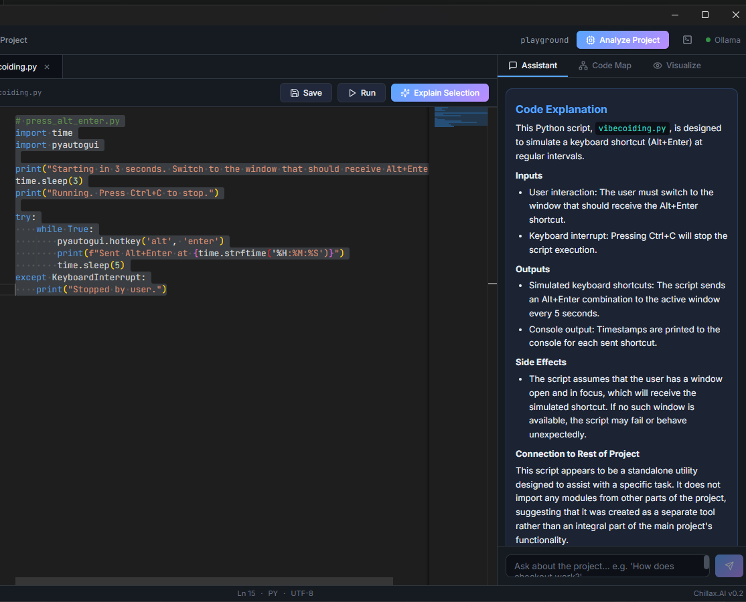
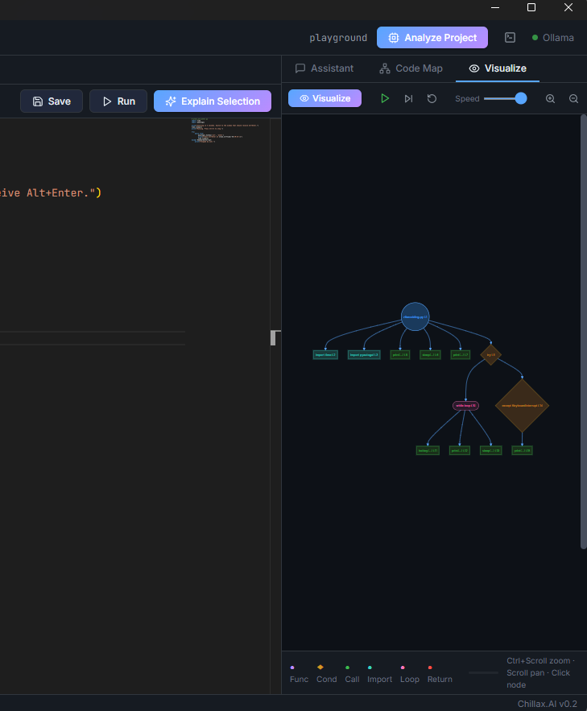
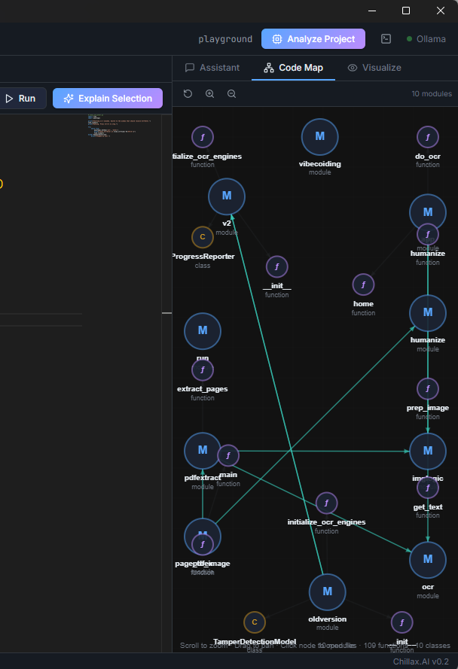

Take the Stress Out of Legacy Code
Chillax.AI
Built for the ET Gen AI Hackathon
Open Innovation Category
Built with ❤️ for ET Gen AI Hackathon 🚀
Team: "Pro"crastinators | Contact: santhnu006@outlook.com

